Slide 1

Ferrybox FA reflectance spectra dataset
AquaINFRA dataset manipulation and cleaning summary
25th April 2025
“Make me a simple and colourful image summarizing water reflectance spectra analysis and cleaning to make a spatio-temporal dataset” prompt. ChatGPT, 14 Apr. version, OpenAI, 23 Apr. 2025, chat.openai.com.

Slide 2
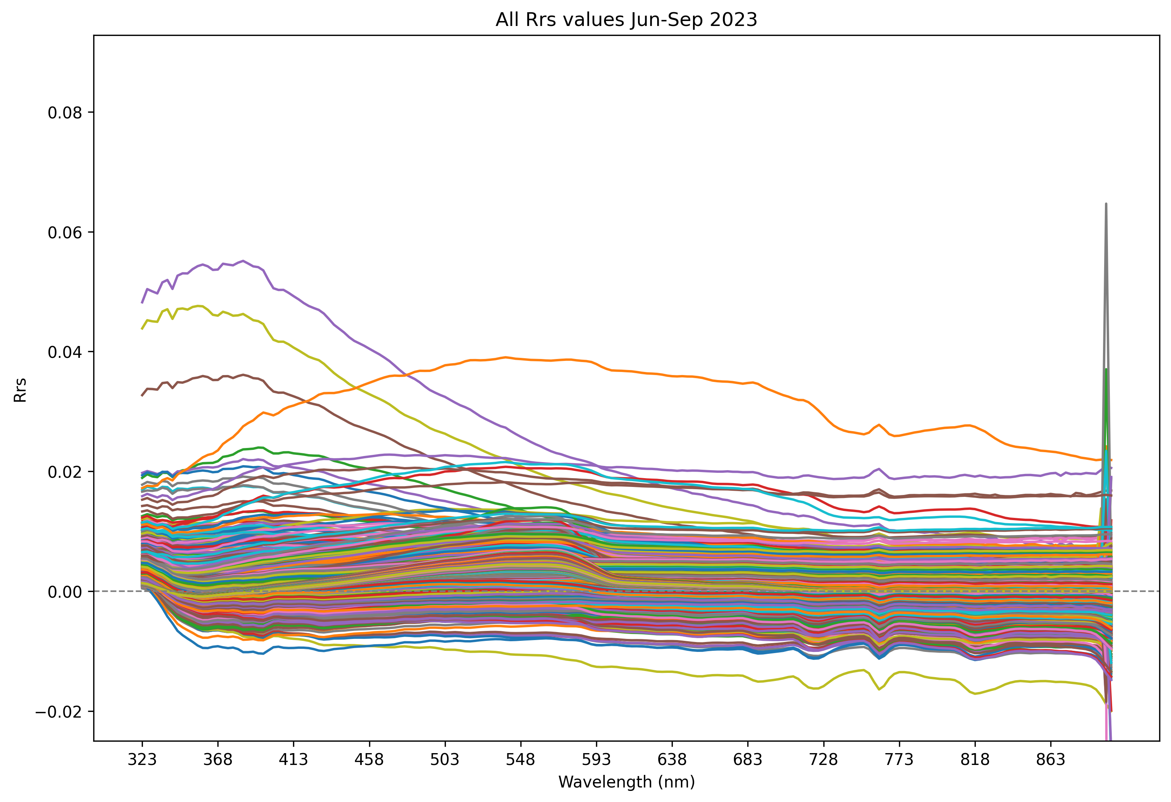
"Good" reflectance spectra June – September 2023
70 629 spectra in total
Passed 4 auto-QC tests
Not in port
Ship shadow
sun azimuth relative to boat course
Sun zenith
sun at least 15° above horizon
Sun glint
sun pointing to the sensor at min. 15° angle
But some spectra have
negative values
spikes
strange curve shapes

Slide 3
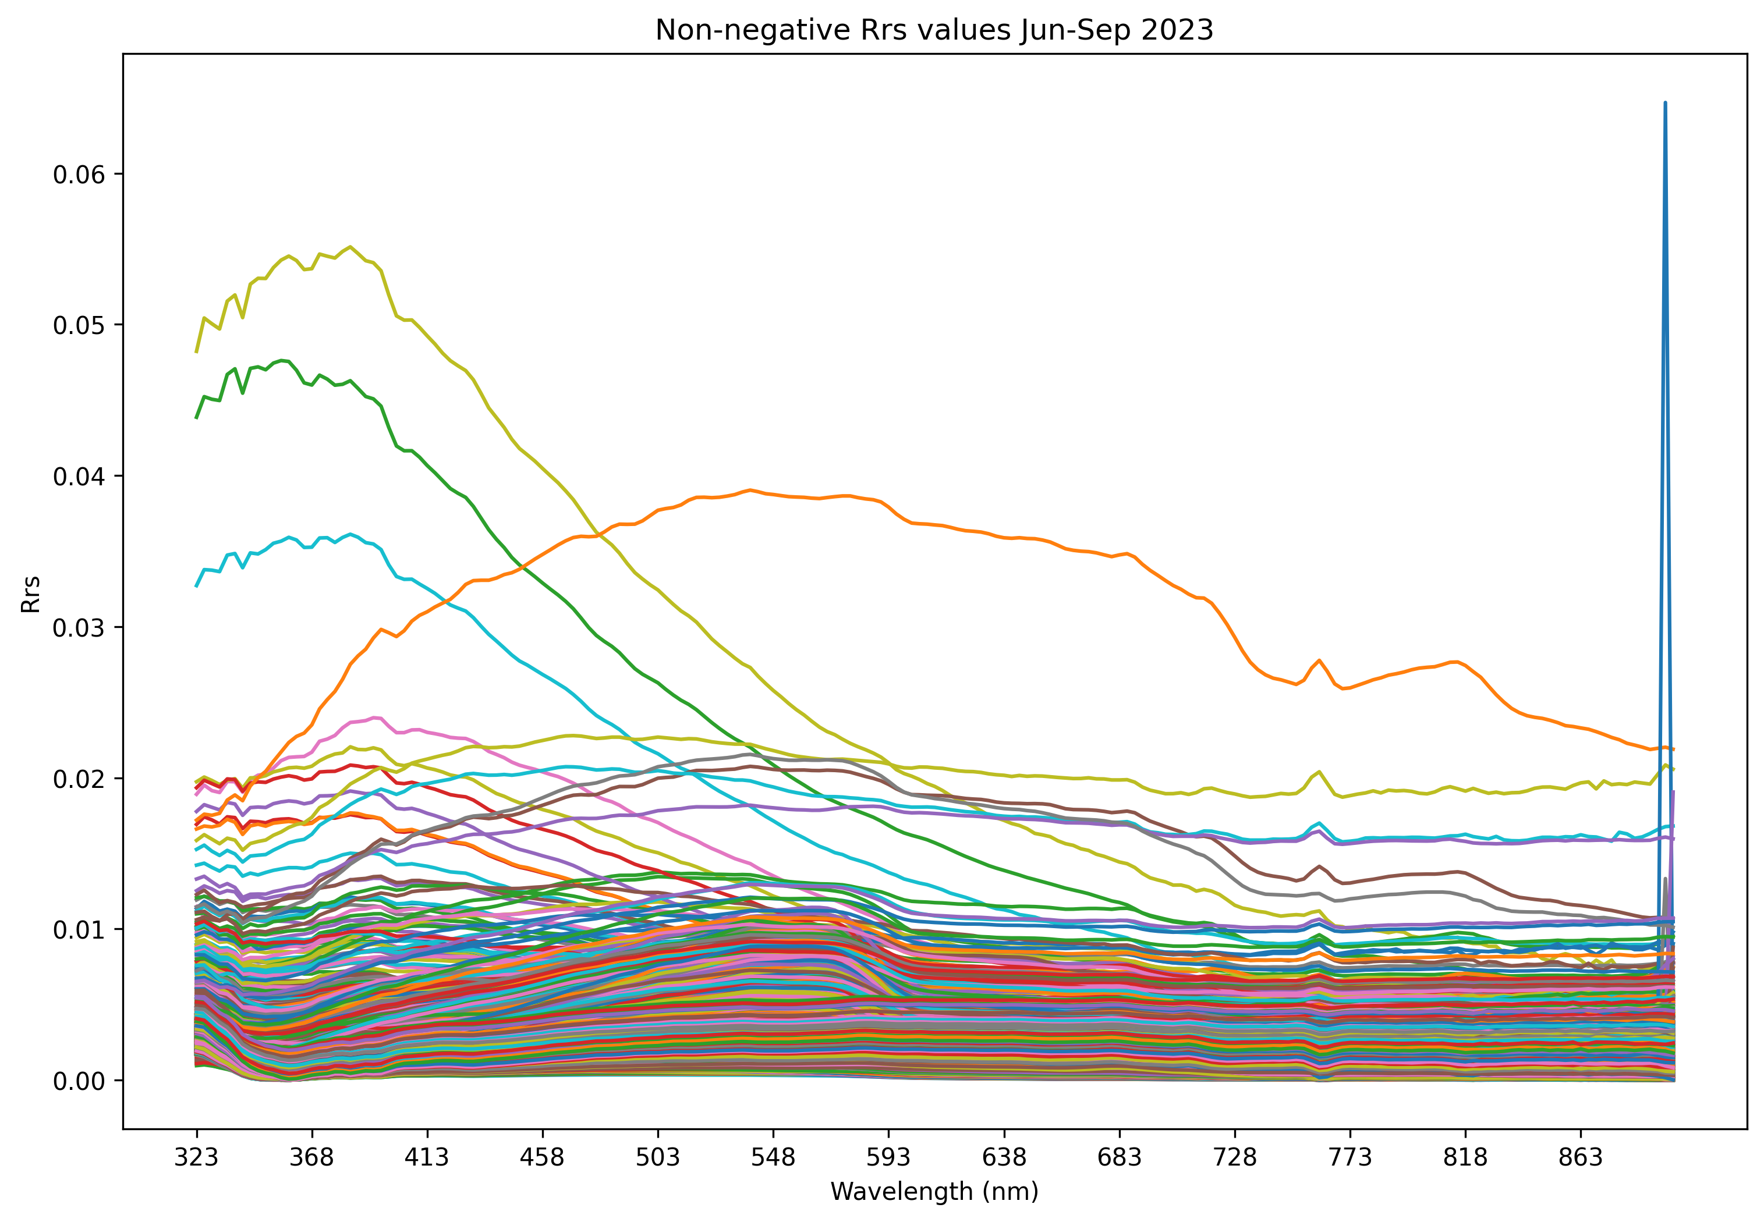
Removing negative reflectance spectra
10 604 spectra remain
85% reduction!
What effect does this have on the data integrity?

Slide 4
Removing negative reflectance spectra impacts (1)
Spatio-temporal coverage
 | All spectra | Non-negative | Change
Time span | 121 days 1 h 39 min 53 s | 121 days 1 h 31 min 23 s | ~ 8.5 min
Latitude | 5.515022° | 5.512733° | − 0.002289° (~ 0.25 km)
Longitude | 0.8431862° | 0.8295132° | − 0.013673° (~ 1 km)
< 0.01% change in time span
~ 0.25km smaller extent from North to South (latitude)
~ 1km smaller extent from East to West (longitude)
=> Marginal effect

Slide 5
Removing negative reflectance spectra impacts (2)
Temporal resolution
 | All spectra | Non-negative | Change
Mean Δt | 2 min 28 s | 16 min 26 s | 5.7 × bigger gaps
St. dev | 55 min | 2 h 38 min | 2.9 × greater variability
Min Δt | 17 s | 17 s | -
1st percentile | 18 s | 18 s | -
10th percentile | 19 s | 19 s | -
Median | 19 s | 20 s | + 5.2%
90th percentile | 22 s | 2 min 47 s | 6.6 × bigger gaps
99th percentile | 43 s | 8 h 6 min | 677 × bigger gaps
Max Δt | 5 d 15 h | 5 d 23 h | + 6%
Average interval increases significantly
More moderate gaps
Many "tighter clusters" of spectra removed (looking at 90th & 99th percentiles)

Slide 6
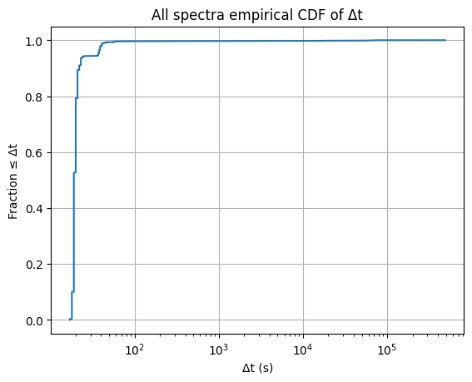
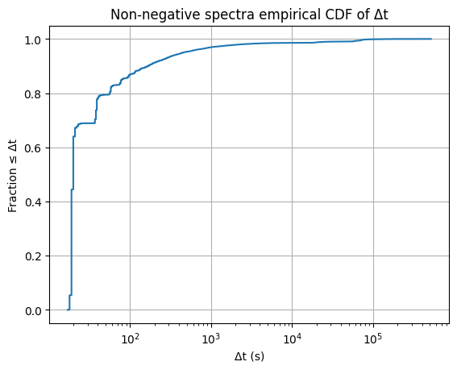
Temporal resolution changes
Very large fraction of all spectra (~ 90%) has time resolution <= 10 s, then a long tail of big-time differences
For non-negative spectra only ~ 70% has time resolution below ~15 s
I.e., a lot of shorter intervals removed => higher fraction of non-negative spectra dataset consists of more moderate gaps
Is this an issue?
We will aggregate to average per minute anyway
Can possibly interpolate

Slide 7
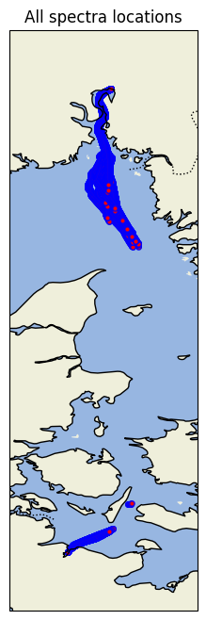
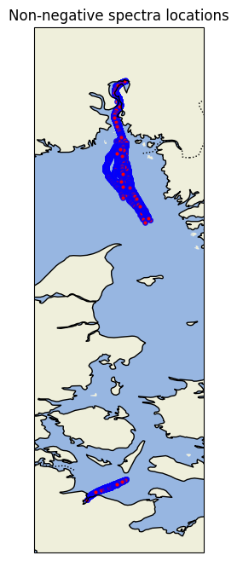
Removing negative reflectance spectra impacts (3)
Spatial resolution
Lower density of data points clearly visible
Only visibly "missing" cluster highlighted
Preliminary conclusion:
Dropping negative values acceptable

Slide 8
Non-negative reflectance spectra
Still some spikes and outlier curves present
Possible next steps:
Share the non-negative spectra as they are
Aggregate to average/minute
Clean further and aggregate to average/minute

Slide 9
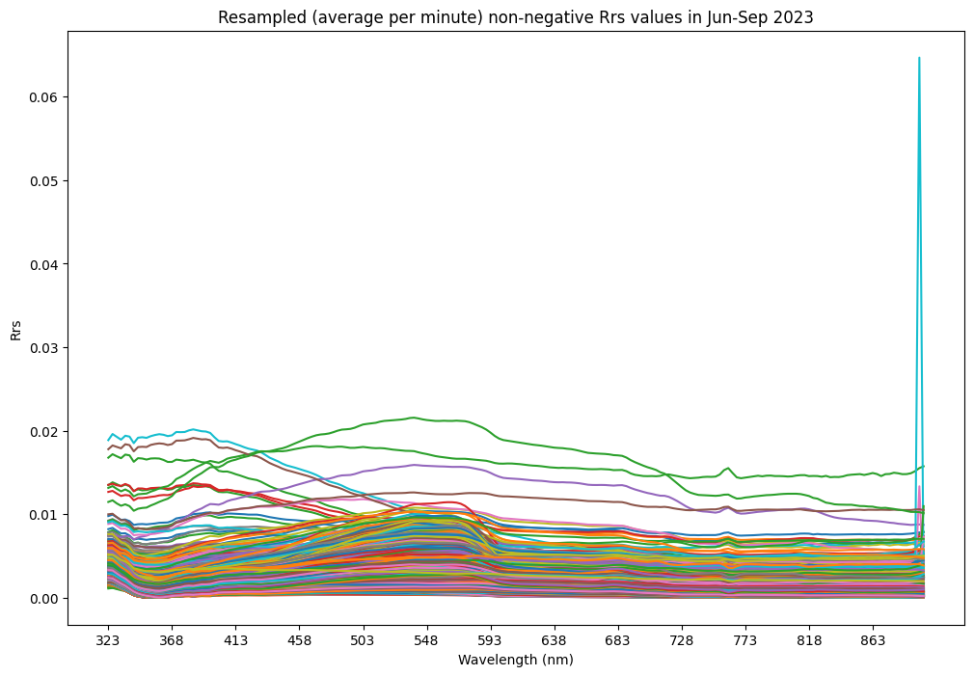
Aggregate of non-negative reflectance spectra
~ 50% reduction in the number of spectra curves
Spikes and outlier curves remain…
Remove the spikes and outlier curves before aggregation?

Slide 10
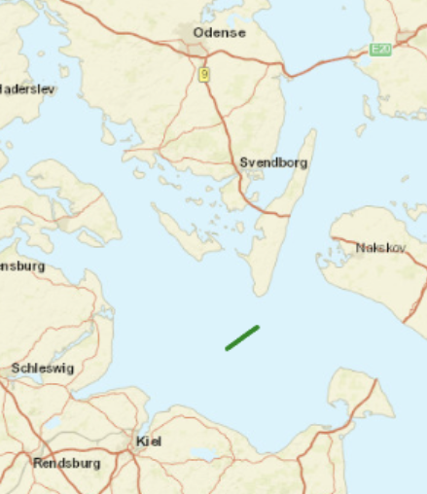
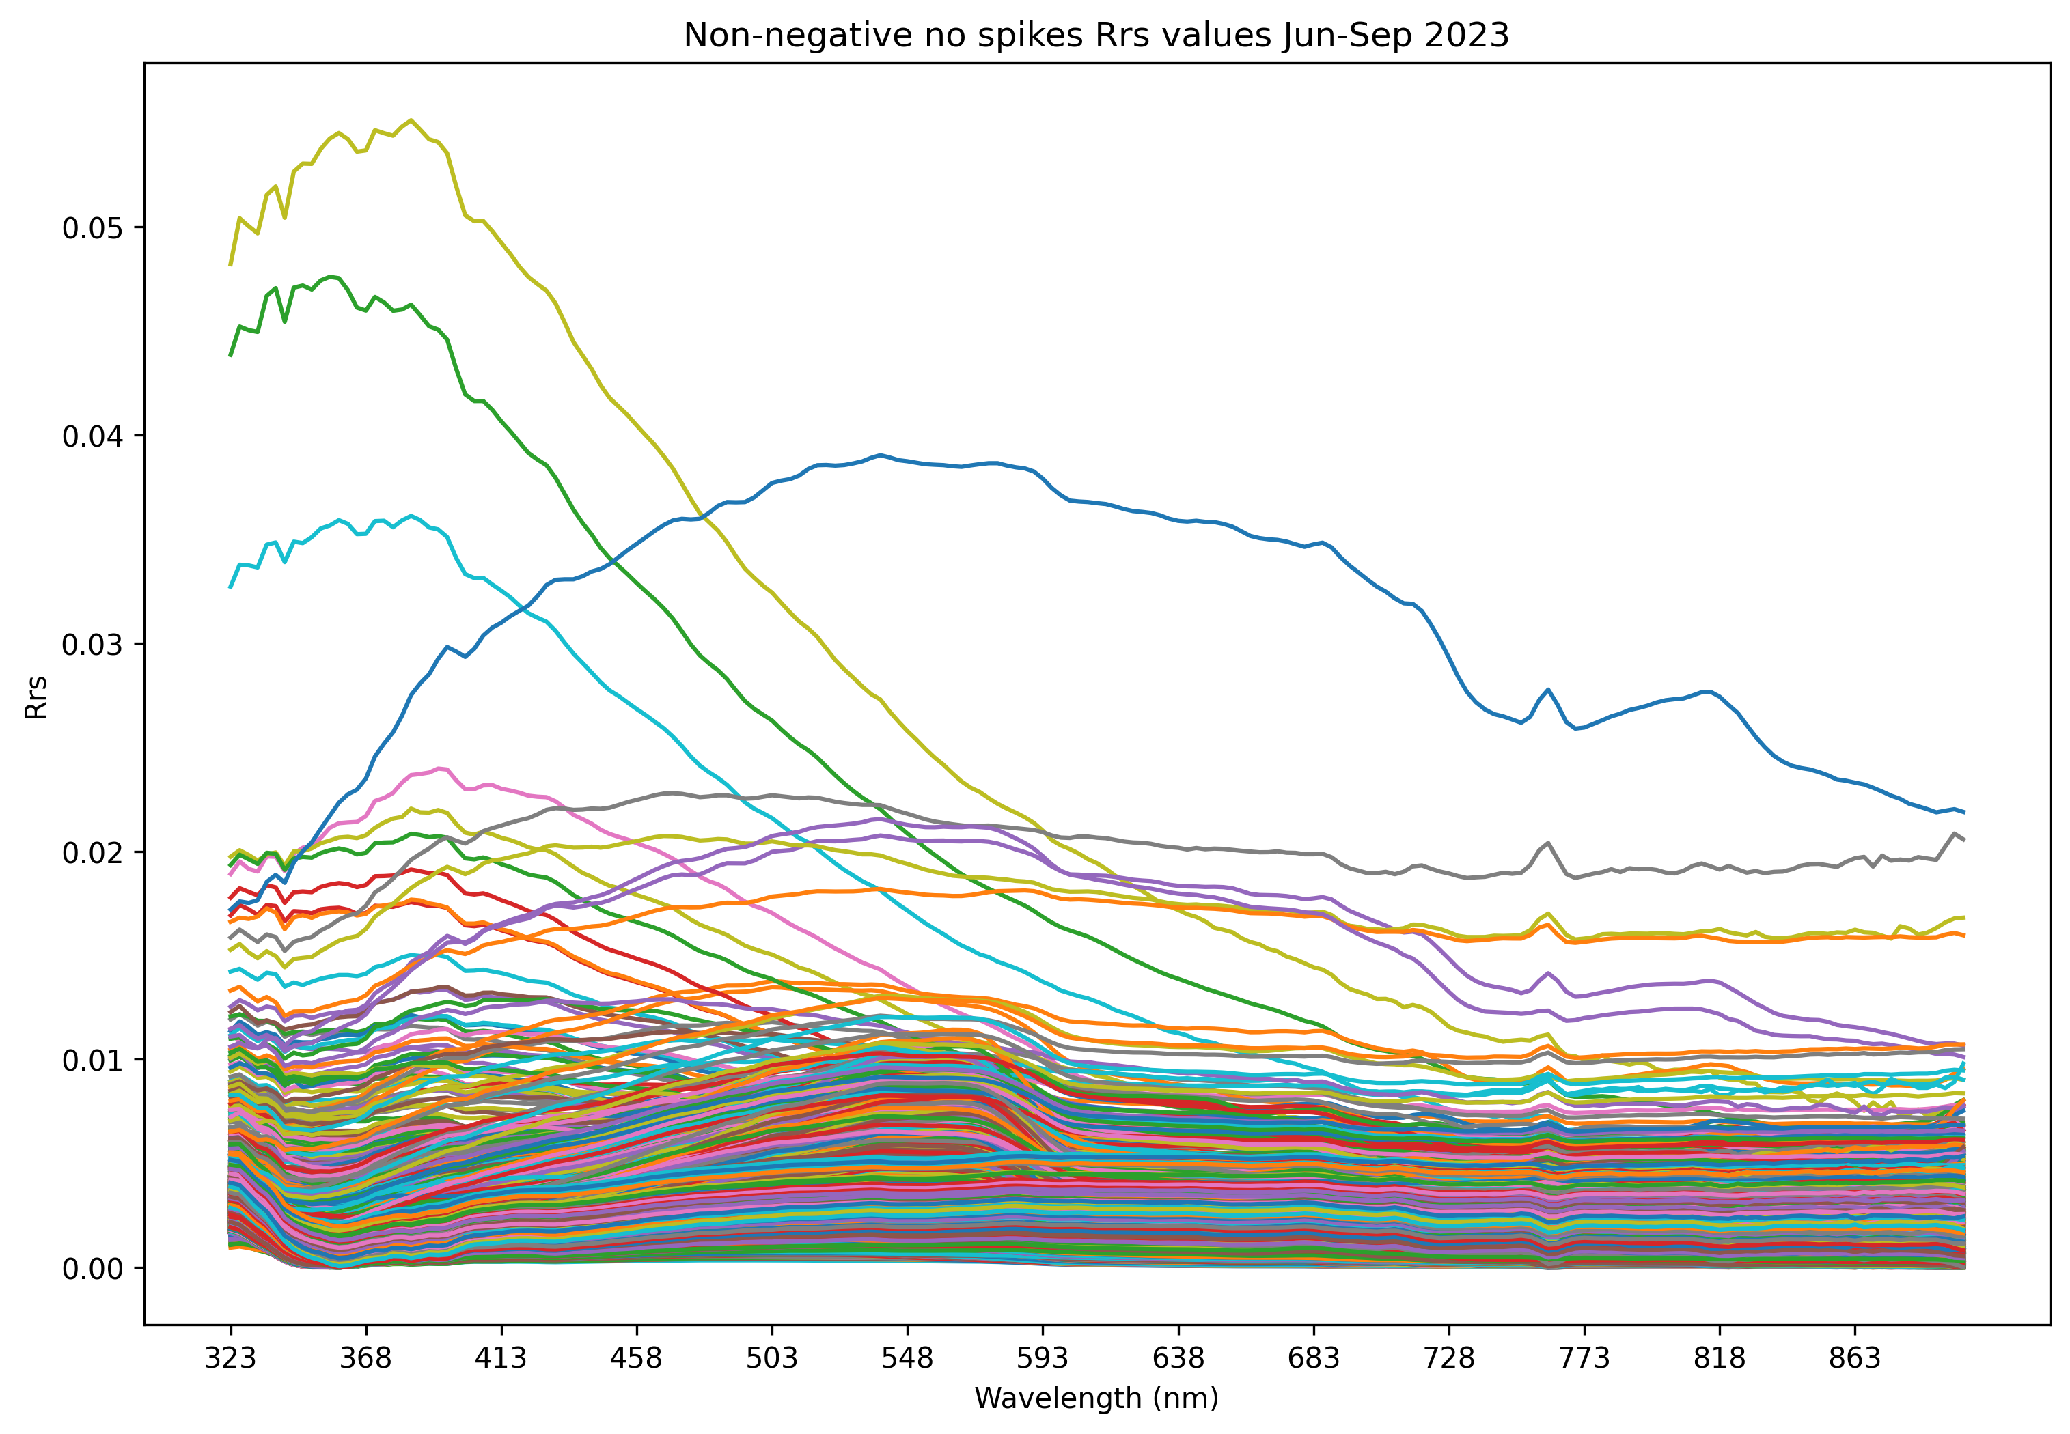
Further cleaning (1)
https://grafana.p.niva.no/d/123502dc-c600-43b8-a4e3-70a962712f4a/ferrybox-214-oceanography?orgId=1&from=1691847660000&to=1691848860000
Spike removal
Spike = slope between 899, 896 and 893 wls > 0.002
Dropped 13 spectra
(~0.12% reduction)
All spikes apart from 1 (top of the table) occur around the same time (and thus location) => significance?
Index | Date | Time
2904 | 2023-07-24 | 14:21:56
8187 | 2023-08-12 | 13:41:38
8190 | 2023-08-12 | 13:49:41
8192 | 2023-08-12 | 13:53:08
8193 | 2023-08-12 | 13:56:09
8194 | 2023-08-12 | 13:56:32
8195 | 2023-08-12 | 13:56:55
8196 | 2023-08-12 | 13:57:18
8198 | 2023-08-12 | 13:58:04
8199 | 2023-08-12 | 13:58:27
8203 | 2023-08-12 | 13:59:59
8204 | 2023-08-12 | 14:00:22
8205 | 2023-08-12 | 14:00:45

Slide 11
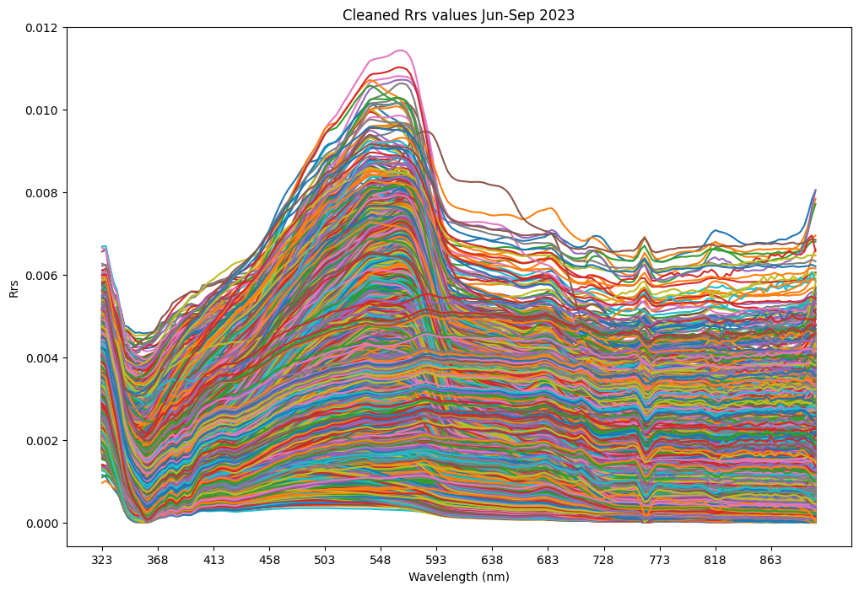
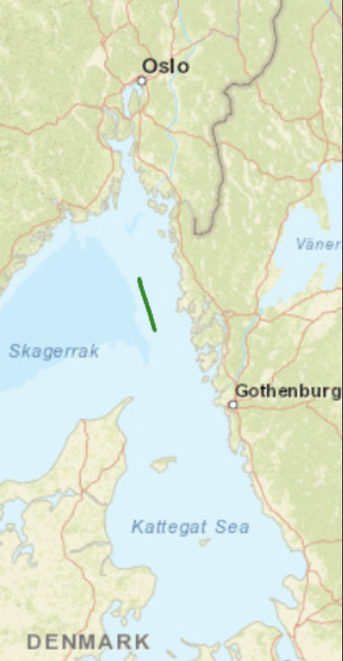
Further cleaning (2)
Outlier removal
Principal Component Analysis (PCA) & covariance estimate to "fit" ellipse to 99% of the data (assuming 1% to be outliers)
Dropped 106 spectra (further ~1% reduction)
51 of those (~half) occurred on 30th June and most between 16:27 – 17:36 => significance?
The rest more scattered
https://grafana.p.niva.no/d/123502dc-c600-43b8-a4e3-70a962712f4a/ferrybox-214-oceanography?orgId=1&from=1688142420000&to=1688146560000

Slide 12
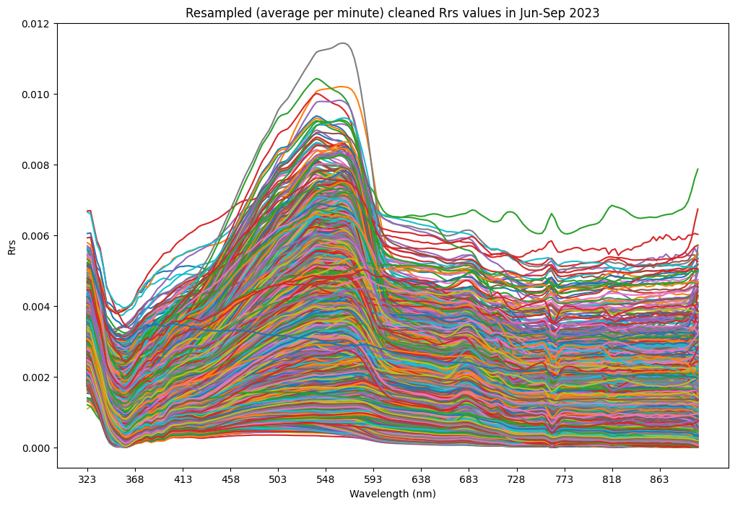
Aggregate of further cleaned reflectance spectra
5 249 spectra
All seem to fairly follow the same profile (drops at wls ~350 & ~750, rise between wls ~400 – 600, etc.)
Final?
Any other analysis needed?

